Slide 1
Introduction to Data Science Data Mining for Business Analytics
Brian d’Alessandro
VP – Data Science, Dstillery
Adjunct Professor, NYU
Fall 2014
Fine Print: these slides are, and always will be a work in progress. The material presented herein is original, inspired, or borrowed from others’ work. Where possible, attribution and acknowledgement will be made to content’s original source. Do not distribute, except for as needed as a pedagogical tool in the subject of Data Science.
Notes:
https://www.youtube.com/watch?v=aMDe5pODkB0 (harlan harris)

Slide 2
Recommendations everywhere
Notes:
The goal of finding structure is to information from one source to reduce uncertainty about another source.
What does this mean? Conditional distribution example. I.e., carnival guy who guesses your weight. If I can see your height I can reduce uncertainty about weight.
Find some height/weight data.
Under supervised exploration:
How can we (automatically) obtain a selection of the more informative variables with respect to predicting the value of the target variable?
Even better, can we obtain the ranking of the variables?
Can think of importance as one that makes the target variable more pure. This leads to the notion of entropy.

Slide 3
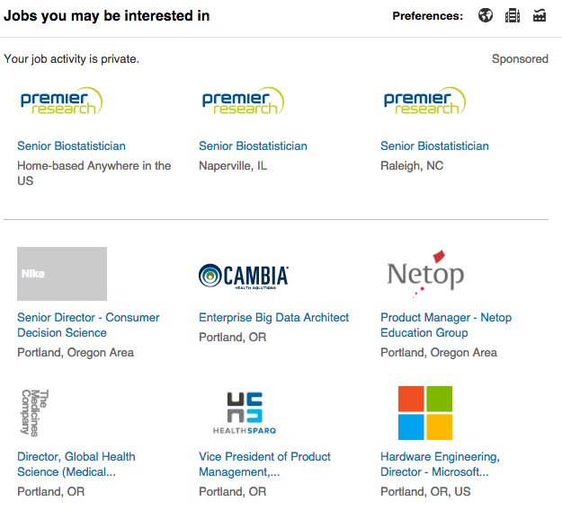
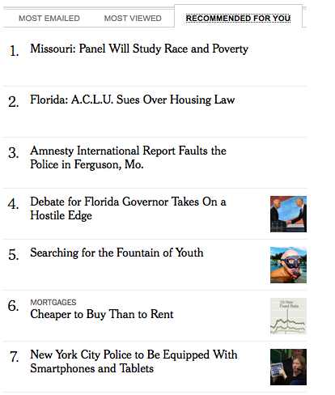

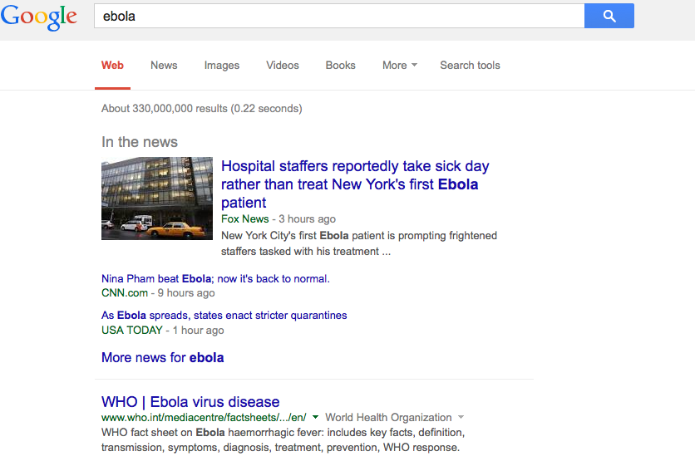

Recommendations are everywhere
If you use the internet, you likely suffer from this little problem - too much information and too little time.
Most companies try to solve this problem for you using data science

Slide 4
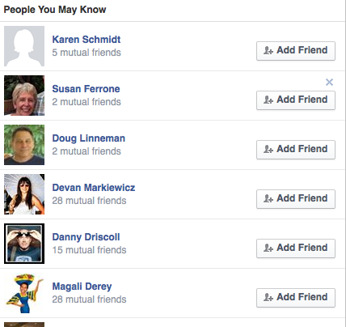

Recommendations drive
Who gets to be your friend…

Slide 5
Recommendations drive
Where you might work …

Slide 6
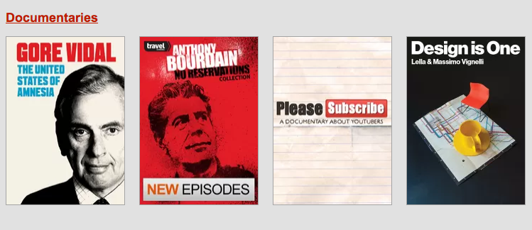
Recommendations drive
What you’ll watch tonight…
rrr

Slide 7
Recommendations drive
The information I am exposed to…

Slide 8
Recommendations are very interesting
There is no single technique, and each problem is unique, though there are some core fundamentals
Evaluation is not obvious, requires creativity and ingenuity
Very few data mining products are this exposed to the public.
What are the design implications of a recommender system?
What are the ethical implications of a recommender system?

Slide 9
How to recommend
Notes:
The goal of finding structure is to information from one source to reduce uncertainty about another source.
What does this mean? Conditional distribution example. I.e., carnival guy who guesses your weight. If I can see your height I can reduce uncertainty about weight.
Find some height/weight data.
Under supervised exploration:
How can we (automatically) obtain a selection of the more informative variables with respect to predicting the value of the target variable?
Even better, can we obtain the ranking of the variables?
Can think of importance as one that makes the target variable more pure. This leads to the notion of entropy.

Slide 10
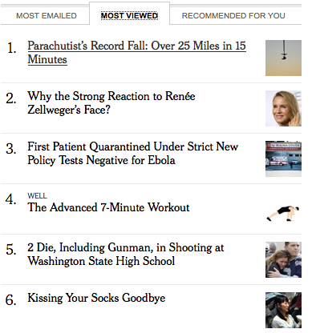
Two philosophical approaches
Recommend what is popular
Try to understand your tastes

Slide 11
We’ll cover
Collaborative Filtering – the basis of item-based recommendations (and the one that started it all)
Clustering Approaches
Page Rank – the billion dollar algorithm, and very effective in networked data
Matrix Factorizations – where recommendations become supervised
Traditional Supervised Approaches

Slide 12
Collaborative filtering

Slide 13
2 types
User based
Find like users and make recommendations based on ratings/scores of like users
Item Based
Find similar items and recommend items similar to an item a user has shown interest in.

Slide 14
User based

Slide 15


intuition
1. Find a group of people who like the same things
2. Not everyone will like the exact same set of things
Lelaina likes…
Nirvana
Sound Garden
Pearl Jam
Troy likes…
Nirvana
Sound Garden
The Pixies

Slide 16

intuition
1. Find a group of people who like the same things
2. Not everyone will like the exact same set of things
3. Recommend the non-overlapping items.
I think you’d like Pearl Jam
We have similar tastes, I’ll check them out.

Slide 17
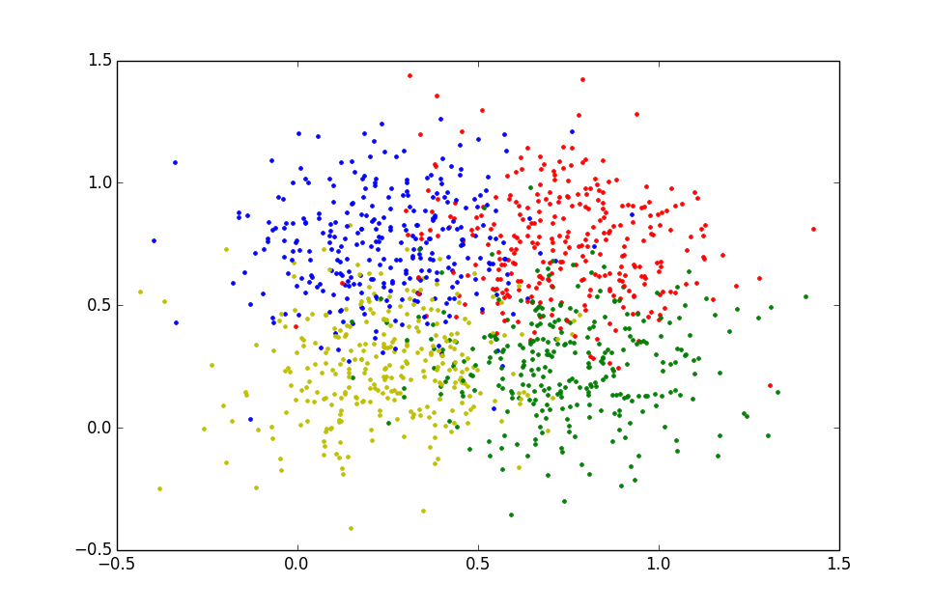
Defining a mechanism for “we have similar tastes”
How do we translate “Find a group of people who like the same things” into a data science algorithm?
Let’s find “Taste” Neighborhoods!

Slide 18
Towards a “taste” neighborhood
First let’s define the data structure.
Let A be the user-item matrix. Each entry a_{ij} can either be a rating or some binary indicator for user i on item j.
 | Item 1 | Item 2 | Item 3 | Item 4 | … | Item K
User 1 | 2 | 1 |  |  | …
User 2 |  | 2 | 4 |  | … | 2
User 3 | 3 |  |  |  | …
User 4 | 1 | 2 | 5 | 3 | …
User 5 | 3 | 2 |  |  | …
User 6 |  |  |  |  | … | 1
User 7 |  | 4 | 1 |  | … | 4
User 8 |  | 4 | 2 |  | … | 5
User 9 | 1 |  |  |  | …
User 10 |  |  | 3 | 4 | … | 1
… | … | … | … | … | …
User N |  |  |  | 1 | … | 4
A =

Slide 19
Towards a “taste” neighborhood
Second let’s create a neighborhood for user i.
 | Item 1 | Item 2 | Item 3 | Item 4 | … | Item K
User 1 | 2 | 1 |  |  | …
User 2 |  | 2 | 4 |  | … | 2
User 3 | 3 |  |  |  | …
User 4 | 1 | 2 | 5 | 3 | …
User 5 | 3 | 2 |  |  | …
User 6 |  |  |  |  | … | 1
User 7 |  | 4 | 1 |  | … | 4
User 8 |  | 4 | 2 |  | … | 5
User 9 | 1 |  |  |  | …
User 10 |  |  | 3 | 4 | … | 1
… | … | … | … | … | …
User N |  |  |  | 1 | … | 4
A =

Slide 20
Towards a “taste” neighborhood
To do this, we need to define user-user similarity or distance.
 | Item 1 | Item 2 | Item 3 | Item 4 | … | Item K
User 1 | 2 | 1 |  |  | …
User 2 |  | 2 | 4 |  | … | 2
User 3 | 3 |  |  |  | …
User 4 | 1 | 2 | 5 | 3 | …
User 5 | 3 | 2 |  |  | …
User 6 |  |  |  |  | … | 1
User 7 |  | 4 | 1 |  | … | 4
User 8 |  | 4 | 2 |  | … | 5
User 9 | 1 |  |  |  | …
User 10 |  |  | 3 | 4 | … | 1
… | … | … | … | … | …
User N |  |  |  | 1 | … | 4
A =

Slide 21
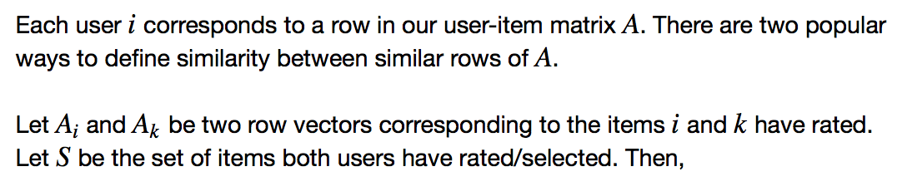
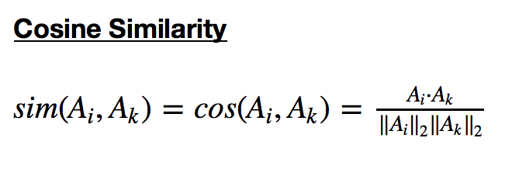
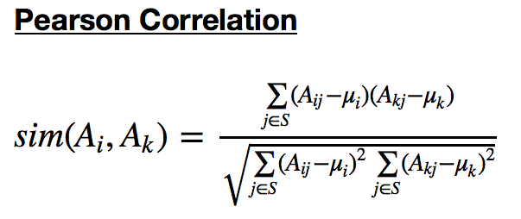
Towards a “taste” neighborhood

Slide 22
A practical aside
Things to consider when choosing a similarity measure:
Which metric is better for ratings vs. binary indicators?
Should you mean normalize? I.e., subtract user and/or item average rating from each rating.
Should take Similarity over all items for each user, or just those in common. I.e, should S be the intersection or union of A_{i} and A_{k}.
The right answer will likely depend on your problem. Testing and experimentation is important in each case.

Slide 23

Making the recommendation
The predicted score/rating for user u on product i is then a function of scores/ratings that all users in u’s neighborhood gave to the same product.
r_{1,i} = 4
sim = 0.75
r_{2,i} = 5
sim = 0.8
r_{5,i} = 4
sim = 0.9
r_{3,i} = 3
sim = 0.7
r_{4,i} = 5
sim = 0.8

Slide 24



Different ways to aggregate
Take a simple average.
Take a weighted avg, weighted by similarity…
There are many other ways to define the aggregation function. Other variants use averages but normalize out the means of the individual users to account for user-specific biases.

Slide 25
EG.
Once you have defined the neighborhood, aggregation is pretty straightforward.
User | ri,j | sim | ri,j*sim
1 | 4 | 0.75 | 3.0
2 | 5 | 0.8 | 4.0
3 | 3 | 0.6 | 1.8
4 | 4 | 0.8 | 3.2
5 | 5 | 0.9 | 4.5
Average |  | 4.20
Weighted Average |  | 4.29
r_{1,i} = 4
sim = 0.75
r_{2,i} = 5
sim = 0.8
r_{3,i} = 3
sim = 0.7
r_{4,i} = 5
sim = 0.8
r_{5,i} = 4
sim = 0.9

Slide 26
item based

Slide 27
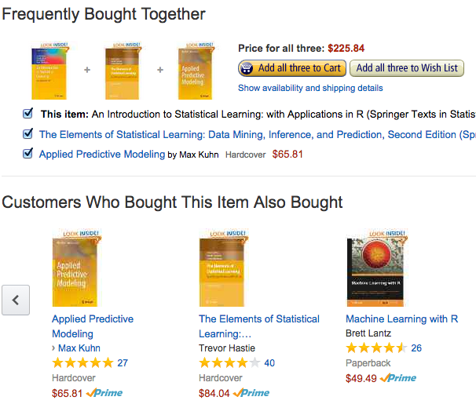
Developed by amazon
User based methods can be unscalable as user-item matrix grows.

Slide 28
Start with user-item matrix
But this time we care about similarity between columns, not rows. We can use the same type of similarity functions that we used in the user based system.
 | Item 1 | Item 2 | Item 3 | Item 4 | … | Item K
User 1 | 2 | 1 |  |  | …
User 2 |  | 2 | 4 |  | … | 2
User 3 | 3 |  |  |  | …
User 4 | 1 | 2 | 5 | 3 | …
User 5 | 3 | 2 |  |  | …
User 6 |  |  |  |  | … | 1
User 7 |  | 4 | 1 |  | … | 4
User 8 |  | 4 | 2 |  | … | 5
User 9 | 1 |  |  |  | …
User 10 |  |  | 3 | 4 | … | 1
… | … | … | … | … | …
User N |  |  |  | 1 | … | 4
A =

Slide 29
Derive the item-item matrix
2 approaches to recommendation:
If a user has selected/purchased an item, find the k most similar items
For each item the user hasn’t selected/purchased, predict user’s rating/score for that product as a function of the user’s rating/score on similar items (similar to the user based kNN approach)
 | Item 1 | Item 2 | Item 3 | Item 4 | … | Item K
Item 1 |  | .8 | 0.2 | 0 | … | 0.1
Item 2 |  |  | 0.5 | 0.11 | … | 0.6
Item 3 |  |  |  | 0.3 | … | 0.4
Item 4 |  |  |  |  | … | 0.8
… | … | … | … | … | … | 0.3
Item K |  |  |  |  | …
M =

Slide 30
A clustering approach
Again we start with the user-item matrix. This time we want to cluster items into similar groups. However, clustering with incredibly high dimension (in this case, the number of users) is a daunting task.
 | Item 1 | Item 2 | Item 3 | Item 4 | … | Item K
User 1 | 2 | 1 |  |  | …
User 2 |  | 2 | 4 |  | … | 2
User 3 | 3 |  |  |  | …
User 4 | 1 | 2 | 5 | 3 | …
User 5 | 3 | 2 |  |  | …
User 6 |  |  |  |  | … | 1
User 7 |  | 4 | 1 |  | … | 4
User 8 |  | 4 | 2 |  | … | 5
User 9 | 1 |  |  |  | …
User 10 |  |  | 3 | 4 | … | 1
… | … | … | … | … | …
User N |  |  |  | 1 | … | 4
A =

Slide 31
Reduce the dimension
A = U Σ V^{T}
Compute SVD of A:
V_{k}
Take first k columns of V:
Cluster items into groups using V_{k,} create item neighborhoods based on the cluster assignments.

Slide 32
What is v_{k}?
V represents the right singular vectors of A.
Each RSV can be considered a concept or latent dimension of A
The first k right singular vectors contribute the most to the matrix A
Each value in V_{k} reflects how important item is is to that particular latent dimension
 | RSV 1 | RSV 2 | RSV 3 | RSV 4 | … | RSV K
Item 1 | 0.1 | 0.15 | 0.41 | 0.14 | … | 0.9
Item 2 | 0.4 | 0.1 | 0.4 | 0.4 | … | 0.4
Item 3 | 0.2 | 0.32 | 0.2 | 0.42 | … | 0.2
Item 4 | 0.6 | 0.4 | 0.76 | 0.6 | … | 0.6
… | … | … | … | … | … | …
Item M | 0.6 | 0.8 | 0.05 | 0.1 | … | 0.6
V_{k} =

